Slide 1
Oil Price Prediction Project
Group - 2

Slide 2
GROUP MEMBERS:
ABDUL NAFIH KT
AJIT INGOLE
PRIYANKA ITALWAR
ANIKET NILA
TANUJA M S
HARSHADA MORE
ASMITA HAMBARDE

Slide 3
Objective:
Oil is a product that goes completely in a different direction for a single market event as the oil prices are rarely based on real-time data, instead, it is driven by externalities making our attempt to forecast it even more challenging As the economy will be highly affected by oil prices our model will help to understand the pattern in prices to help the customers and businesses to make smart decisions.

Slide 4
Project stepwise
Importing dataset
EDA
Pre-processing
Model building
Deployment
Finalizing the best model

Slide 5
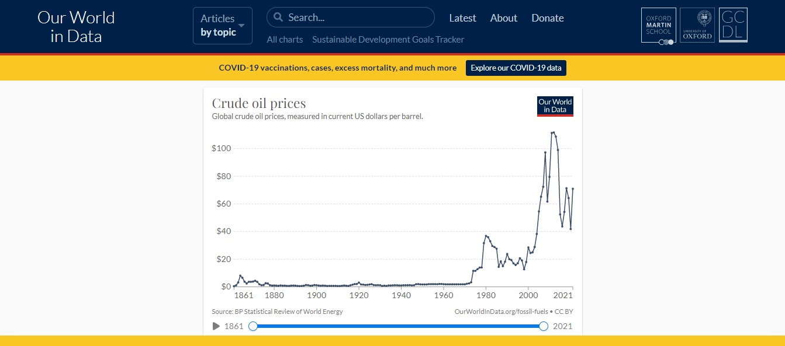
Data Extraction The data is extracted from https://ourworldindata.org/grapher/crude-oil-prices

Slide 6
Importing Library And Dataset
Pandas is a Python library for data analysis
Pandas is built on top of two core Python libraries, matplotlib for data visualization and NumPy for mathematical operations.

Slide 7
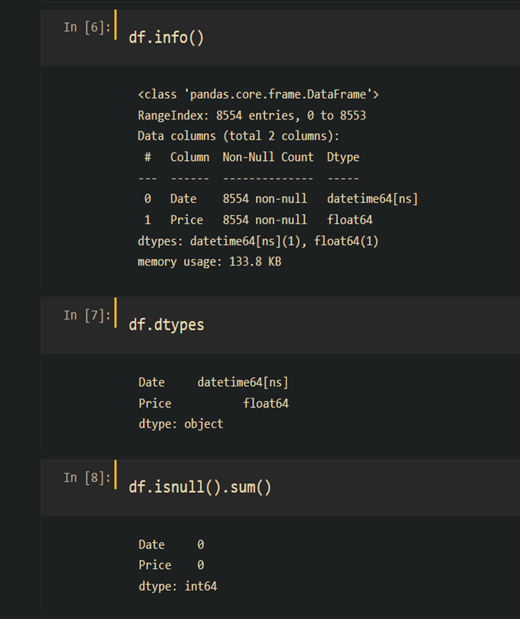
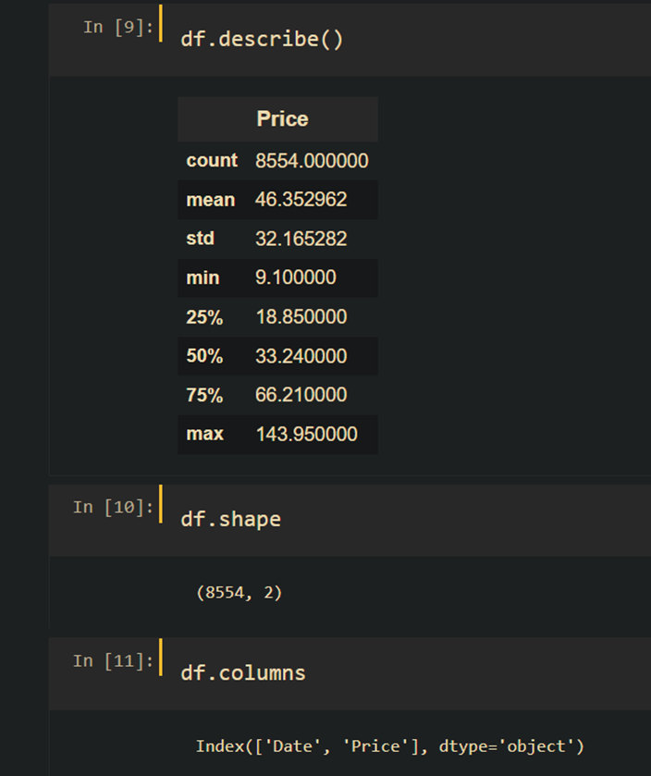
Data Understanding and EDA
Data information
Data types
Checking of Null Values
Description of the data
Shape of Data

Slide 8
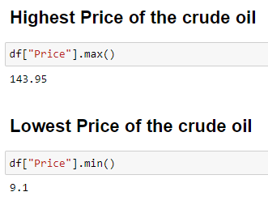
Highest & Lowest Crude oil prices

Slide 9
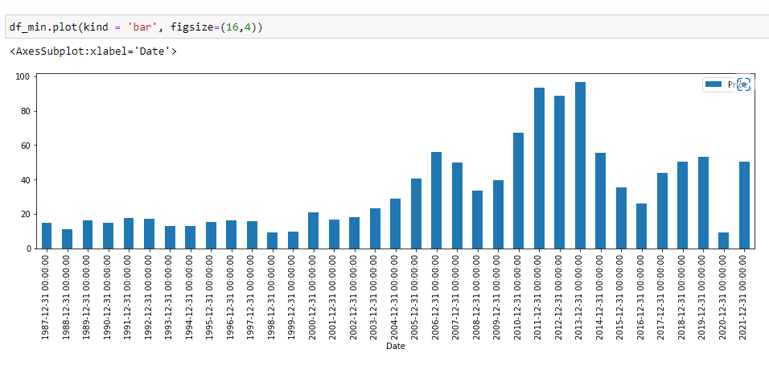
Minimum Crude oil prices of each year

Slide 10
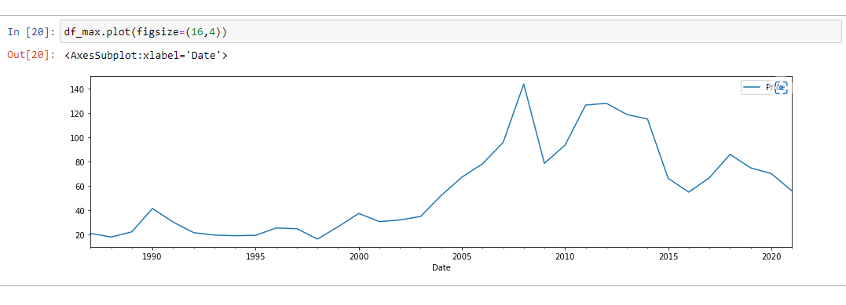
Maximum Crude oil price Graph

Slide 11
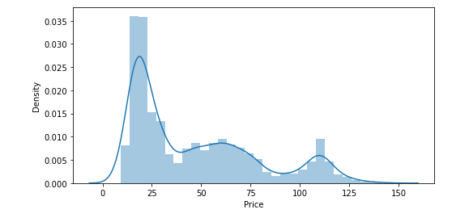
Checking the distribution of Price

Slide 12
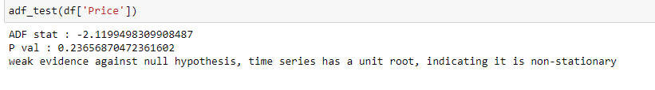
Checking Stationarity of Data using ADFULLER
Here We can Clearly see our P value is 0.23 so our data is not Stationary.

Slide 13
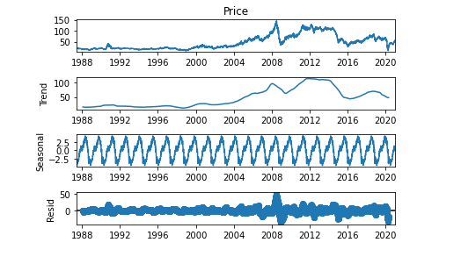
Time-Series Decomposition to understand the trend and Seasonality
Here we can see Trend ,Seasonal and residual of Our data
After 2000 we can see a small hike in price of fuel till 2008 Again it come down for 2010

Slide 14
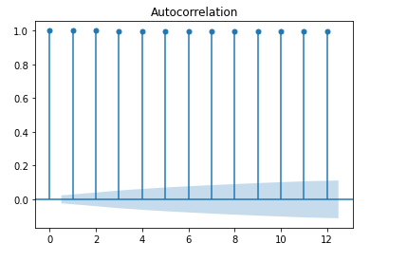
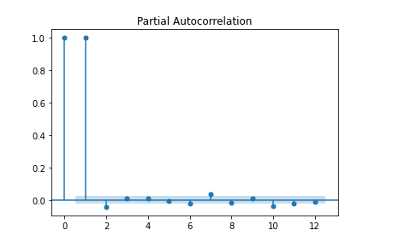
ACF and PACF
Autocorrelation is the relationship between two values in a time series.
The partial autocorrelation function, like the ACF, indicates only the association between two data that the shorter lags between those observations do not explain.

Slide 15
Root Mean Square Error
 | MODEL | RMSE Values
1 | Linear Model | 36.603755
2 | Quadratic Model | 27.518104
3 | Exponential Model | 42.563750

Slide 16
Mean absolute percentage error
 | METHODS | MAPE Values
1 | Simple Exponential Method | 21.346358
2 | Holt Method | 25.644002
3 | Holts winter exponential smoothing with additive seasonality and additive trend | 22.473933
4 | Holts winter exponential smoothing with multiplicative seasonality and additive trend | 22.464584

Slide 17
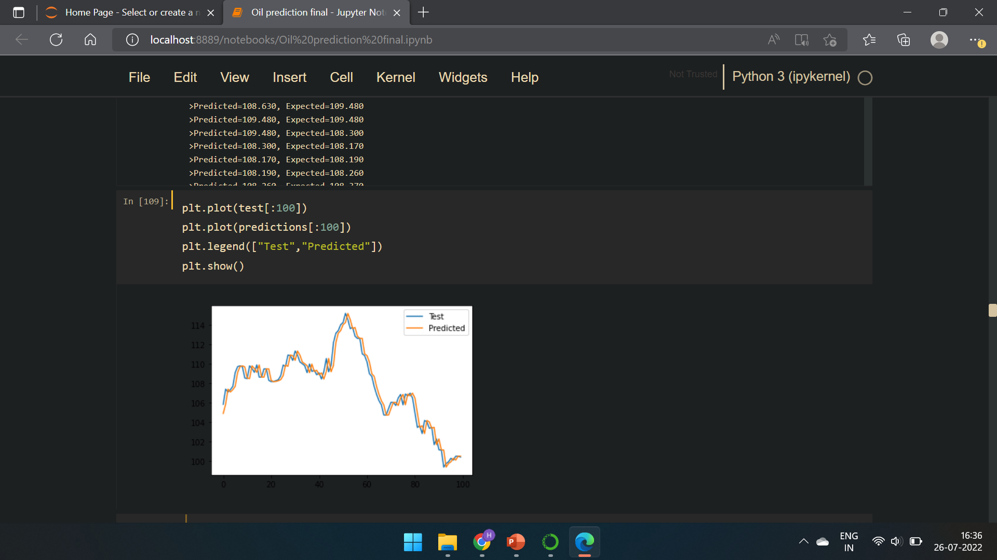
Naïve forecast Model
By Testing Model it is performing well but for forecasting future values,
Naïve forecast was not useful.

Slide 18
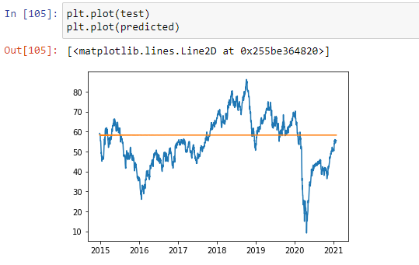
Arimax
By Testing Model it is not performing well for Arimax

Slide 19
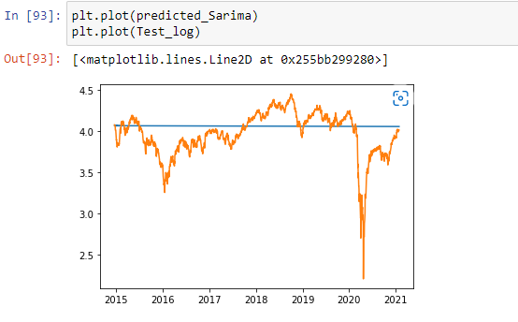
Sarimax
By Testing Model it is not performing well for Sarimax.

Slide 20
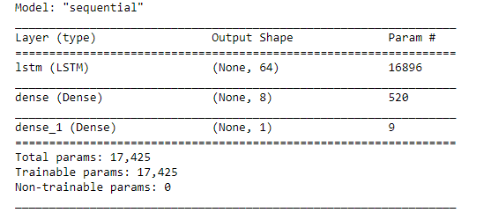
LSTM Model

Slide 21
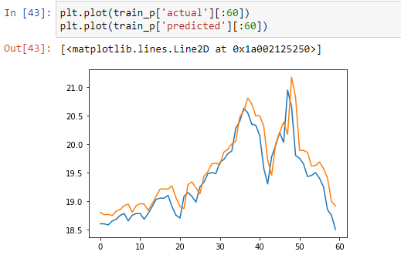
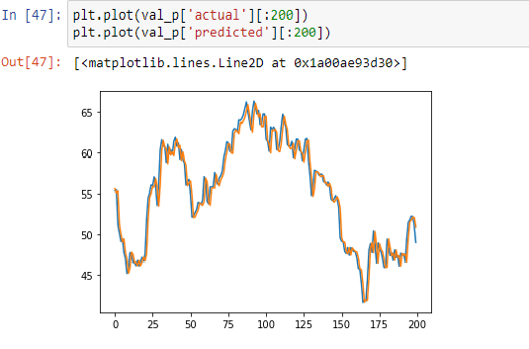

Slide 22
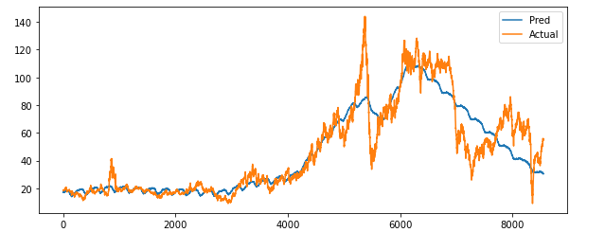
FB Prophet Model

Slide 23
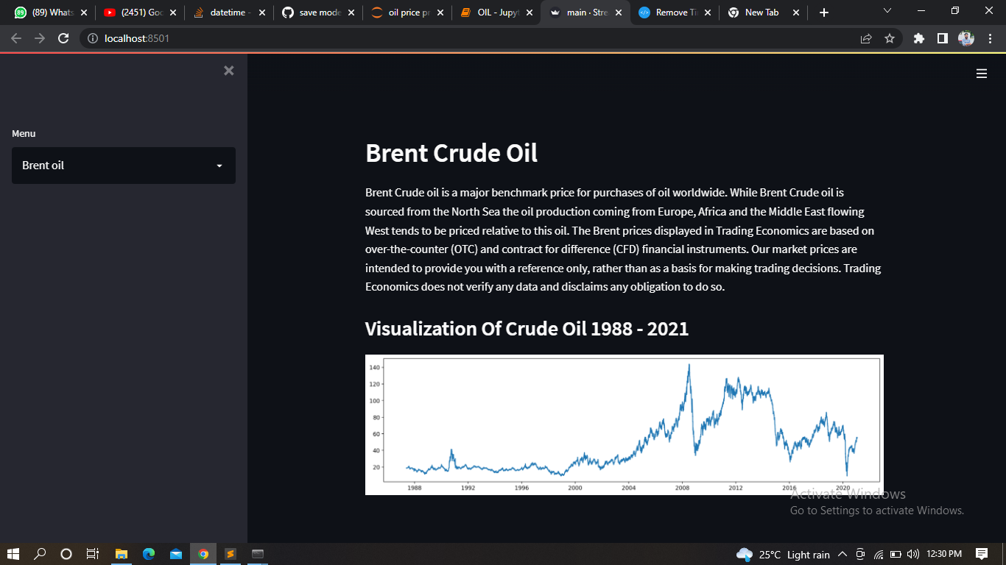
Final Model using LSTM and FB Prophet Model

Slide 24
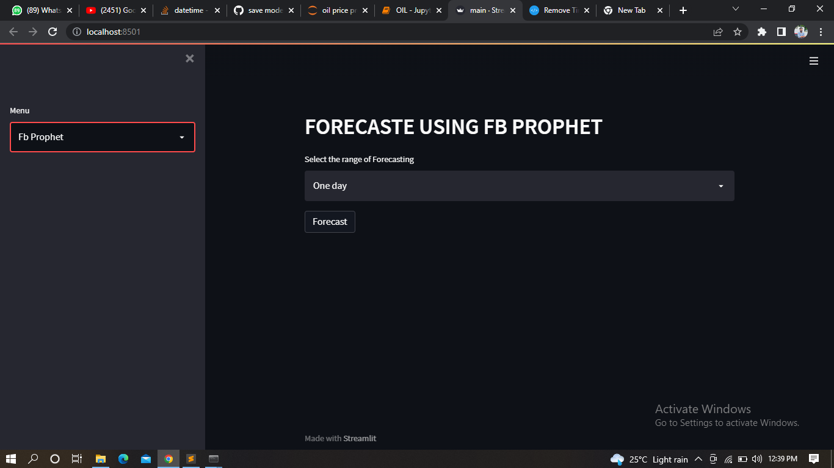

Slide 25
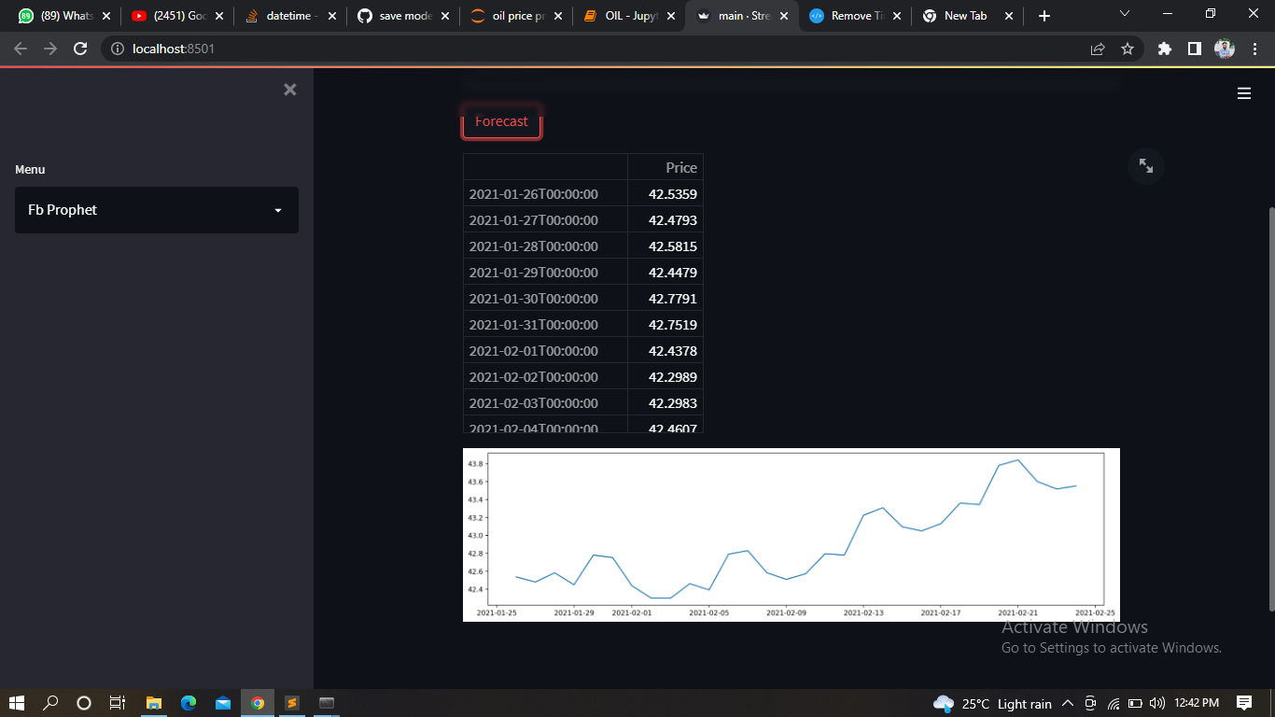

Slide 26
Challenges-
Data was not stationary So we used several transformations to check whether there's any change or seasonality in the data. Also the dataset doesn’t contain the external features affecting the crude oil prices like the supply and demand, inventory, speculation monetary market etc.
The long hyperparameter tuning time ARIMAX and SARIMAX was also challenging.
In Model building we compared performance of several models, in that LSTM was giving the best results for train as well as test data.
When we used LSTM for forecasting, results were not good. Whereas FB prophet was giving average results and the forecasting was also good. So we changed our finalized model from LSTM to FB Prophet.
Deployment model required a specific date-time format which added another step to pre-processing of the dataset.

Slide 27
Thank You

